Slide 1

Pertinent anatomy and outcome data on laparoscopic sacrocolpopexy.
Stephen T Jeffery
University of Cape Town, South Africa
Urogynaecology and Laparoscopy Clinic

Slide 2
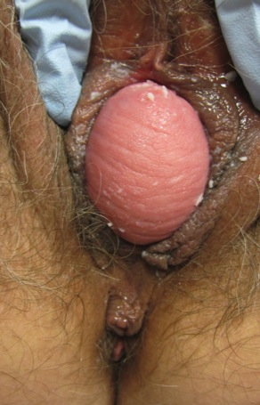
Case Presentation
52 year old
Previous vaginal hysterectomy and sacrospinous fixation for prolapse
Now with stage 3 anterior and apical prolapse
BMI 32, smoker, IHD
Surgical options?
Notes:
Before we begin, lets look at a common clinical case scenario. This is a 52 year

Slide 3
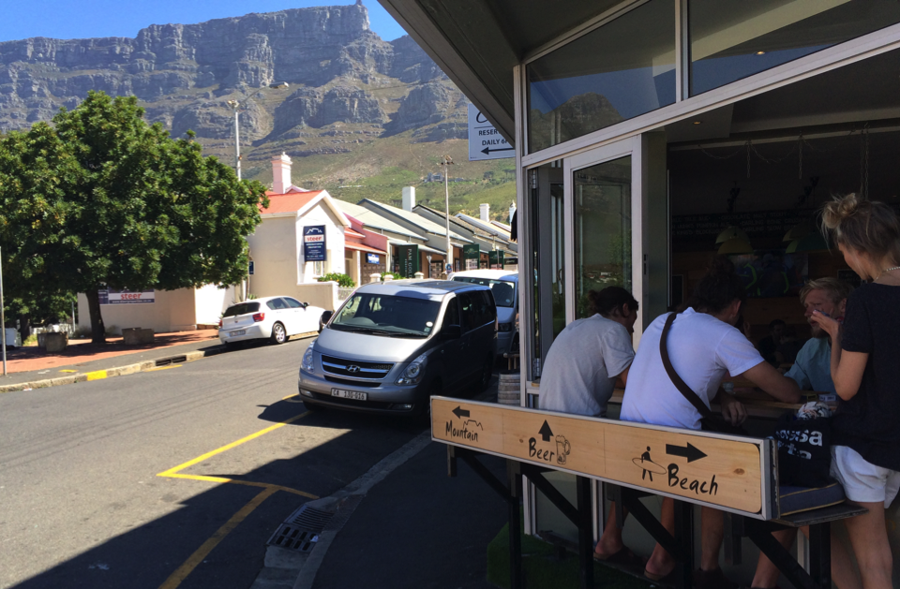
Notes:
Some choices in life are difficult – as many of you will see when you come to IUGA 2016 in Cape Town

Slide 4



Slide 5

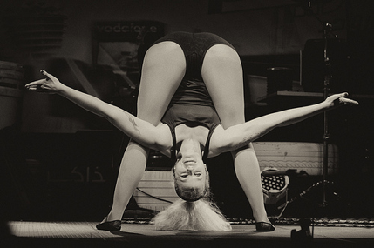

Notes:
As we know, we can approach this surgically from an abdominal or vaginal route.

Slide 6
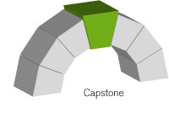
Notes:
We all agree that the vaginal apex is the capstone of support and in women with advanced prolapse, adequate suspension at this level is going to make the ultimate difference to whether the operation is a success or failure. The essence of what we’re talking about today is the best way to achieve support of the vaginal apex

Slide 7
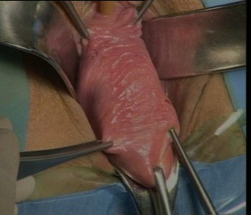
Apical Prolapse: Support options
Vaginal
  Sacrospinous Fixation
  Illiococcygeus Fixation
  Uterosacral Ligament Suspension
  Colpoclesis
  Mesh Kits
Abdominal
  Sacrocolpopexy
  Sacrohysteropexy
Notes:
More than 40 operations for vault prolapse have been described.

Slide 8
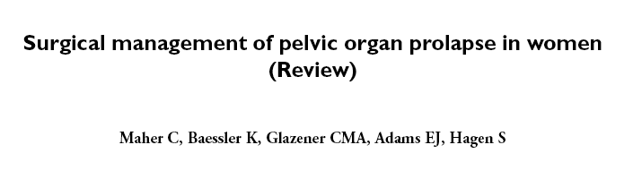

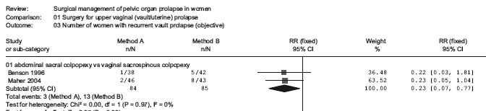
Apical Prolapse
Notes:
But it was really the first data comparing the SSF to the sacrocolpopexy that made us realise that it was most likely the gold standard. This is a graph from one of the first cochrane reviews showing clear superiority for the abdominal route

Slide 9
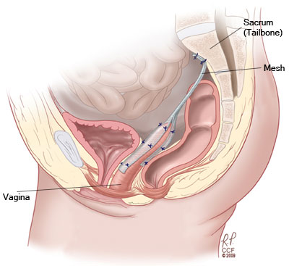

Slide 10
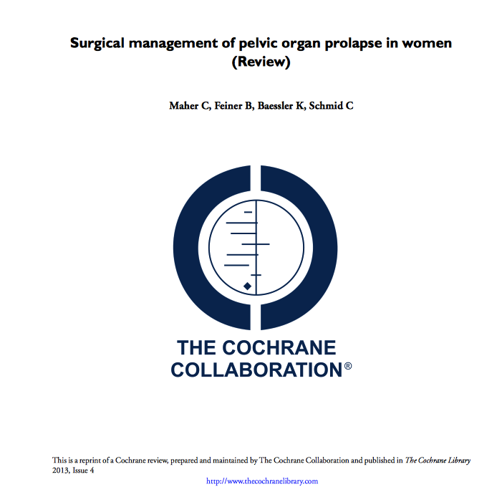
Notes:
This was re-inforced by the recent review in 2013, where

Slide 11

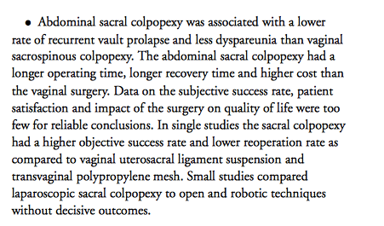
Notes:
It was shown to be associated with lower rate of recurrent vault prolapse and dyspareunia than sacrospinous colpopexy

Slide 12
Notes:
While data on subjective success rate, patient satisfaction and QOL where too few for reliable conclusions,

Slide 13
Notes:
Sacrocolpopexexy was associated with a lower re-operation rate than SSF and vaginal mesh

Slide 14
Outcomes Open Sacrocolpopexy
Nygaard (Syst review) 78-100% Apical success
CARE trial 2 year follow up 95% apical success with 4 % re-operation
Nygaard IE, McCreery R, Brubaker L et al Obstet Gynecol. 2004;104(4):805–823
Brubaker L, Nygaard I, Richter HE, et al.Obstet Gynecol. 2008;112:49–55.
Notes:
Open sacrocolpopexy has consistently been shown to have excellent outcomes with Ingrid Nygaard’s widely cited systematic review showing apical success rates of up to 100%. The CARE trial also quoted excellent success rates with a re-operation rate of 4%

Slide 15
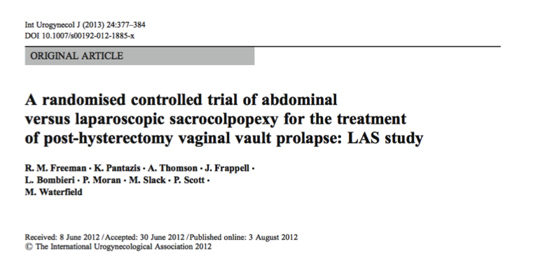
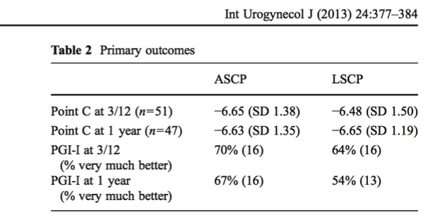
Notes:
Bob Freeman was next to show that the laparoscopic route was as good at the open sacrocolpopoexy

Slide 16
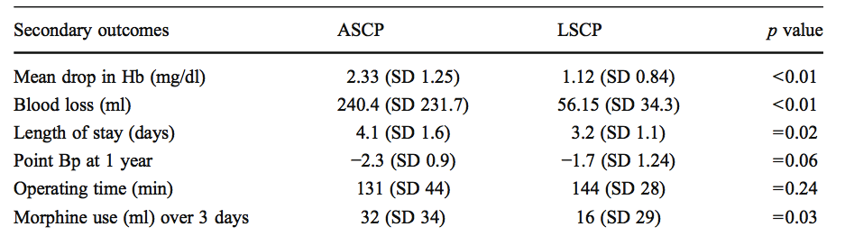
Notes:
With less blood loss, a shorted hospital stay, the same operating time.

Slide 17
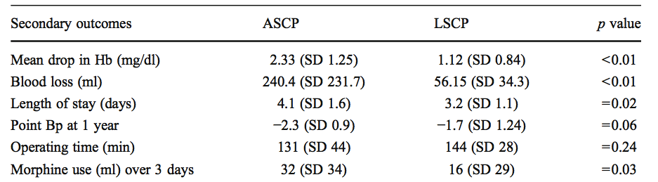
Notes:
With less blood loss, a shorted hospital stay, the same operating time.

Slide 18
Notes:
With less blood loss, a shorted hospital stay, the same operating time and less pain

Slide 19
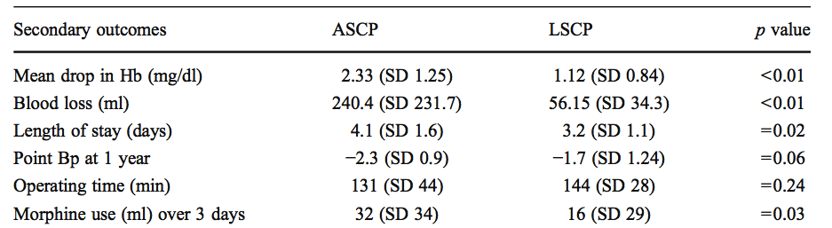
Notes:
With less blood loss, a shorted hospital stay, the same operating time and less pain

Slide 20
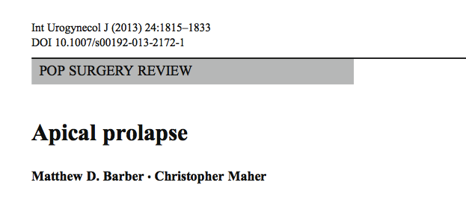
Laparoscopic sacrocolopopexy
  Mean objective success 90.5%
  Subjective success 79-98%
  Mean re-operation rate 5.9%
    For complications 2.9%
    For recurrence 1.8%

Slide 21
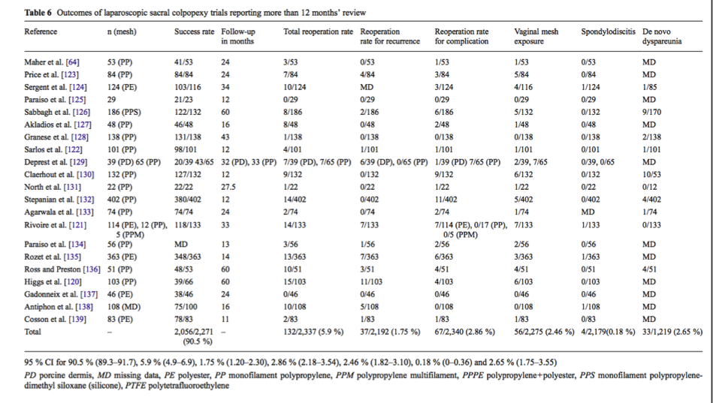
Notes:
A large number of sttudies have shown the laparoscpic route to be successful

Slide 22
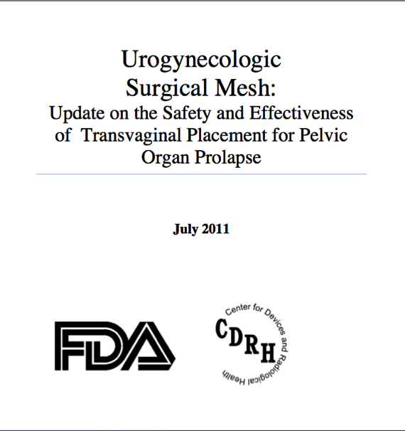
Notes:
The interest in sacrocolpopexy also expanded with the increasing awareness of the complications of vaginal mesh procedures highlighted by the FDA

Slide 23
Sacrocolpopexy may be better
Notes:
This then leads into their final point point on safety. This point is well made in a very good paper by Maher

Slide 24
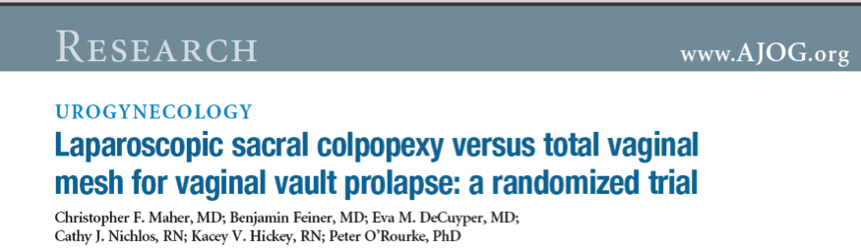
Laparoscopic
Sacrocolpopexy
vs
Total prolift
Notes:
Another game changer was the Chris Maher’s RCT comparing prolift to Laparoscopic SCP

Slide 25
Objective success
(POP-Q stage 0 or 1 at all sites)
TVM
43%
Sacrocolpopexy
  77%
Notes:
LSCP was clearly not only better in term of success rates

Slide 26
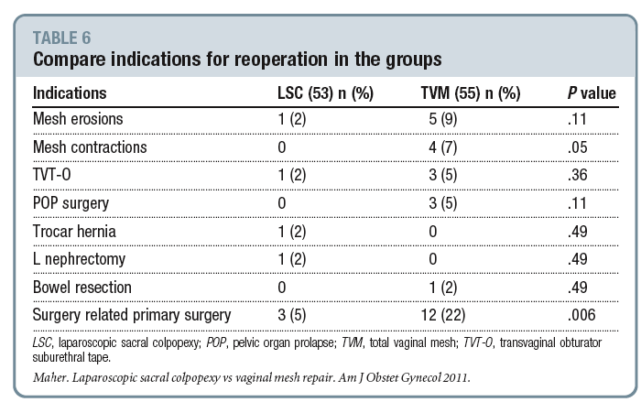
Notes:
But the re-operation rates were also profoundly lower in the laparoscopic group

Slide 27
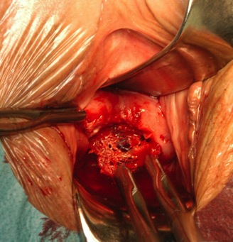
Notes:
A large part of this discussion really hinges on complications

Slide 28
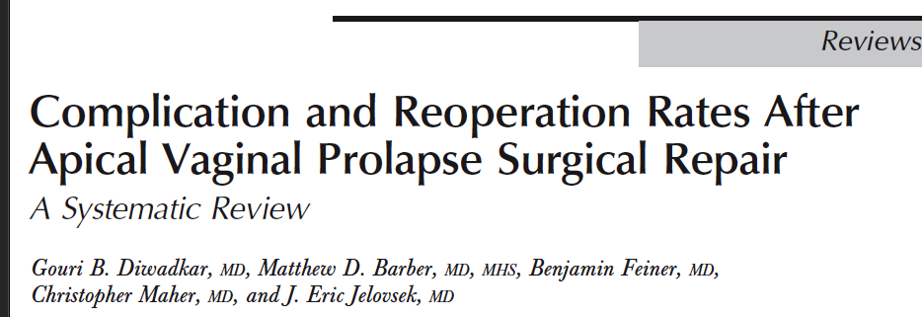
Re-operation for complications 1.9% 4.8% 7.2%
Notes:
It was this systematic review that that demonstrated the excellent return on investment when compared to mesh kits and traditional repair , which included SSF and HUSLS.

Slide 29


Notes:
Now we all know that patienst do not read the books and most of the time when deciding on an ideal approach, we are balancing risks and benefits. There are some factors that make laparoscopic approcahes more risky and this includes obesity and previous surgey

Slide 30

Complications
Sacrocolpopexy
Bowel injury
Ileus
Osteomyelitis
Bladder injury
Longer anaesthesia
Vaginal native tissue/
mesh surgery
Erosion
Higher failure rate
Vaginal pain
Sexual dysfunction
Notes:
We really are balncing risks and benefits

Slide 31

(N=249)
  Bladder injury 0.4%
  Ureter injury 0%
  Bowel injury 1.2%
  Vascular injury 0.8%
  EBL>500ml 0%
  Pelvic Abscess 0.8%
  Osteomyelitis 0%
  Ileus 0.8%
  Neurologic injury 3.6%
  Mesh exposure 2.4%
Notes:
Which brings me to this good study by by Unger et al who incidentally showed that the minimally invasive colpopexy is associted with relatively few complications

Slide 32
Abdominal approach to uterine prolapse
Sacrohysteropexy
Total Hyst and sacrocolpopexy
Supracervical Hyst and sacrocolpopexy
Notes:
While scp has been done extensively for vault prolapse, recently it has become popular for uterine prolapse and this may involve either ----------------

Slide 33
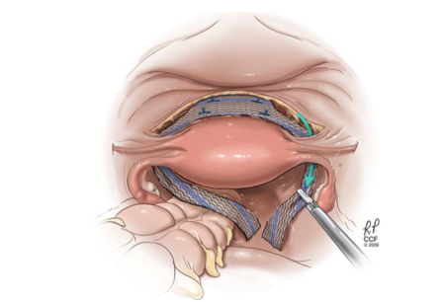
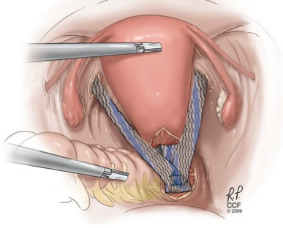
Sacrohysteropexy
Notes:
And then pulling these 2 legs through and onto the promnotory. A second mesh strip is then attached onto the posterior part of the uterus in most cases. Another variant of this op is to simply attach a piece of mesh onto the posterior part of the uterus.

Slide 34
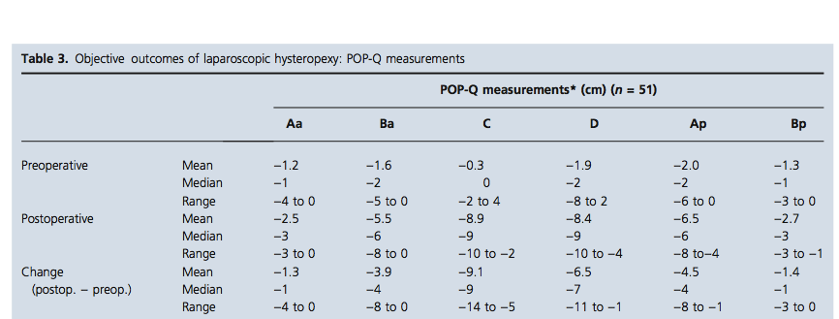
Notes:
This is a series by a group in Oxford demonstrating good outcomes for the apex

Slide 35
Conclusion for SCP
History and data are on the side of the Laparoscopic
Higher success
Probably lower complication rates
Not a quick fix or short –cut but requires skill

Slide 36

Laparoscopic sacrocolpopexy: The Learning Curve
Lap SCP
TAH
Vag hyst
Ovarian Cystectomy
Notes:
The biggest issue in the general availabiliy of lap scp is the learning curve. Bruno and Rob will be giving you a number of tips on how to do this operation competently. One of the essential aspects is understanding the anatomy.

Slide 37
Anatomy

Slide 38

Retroperitoneum and promontory
Notes:
One the more intimidating areas is the retroperitoeum and promontory.

Slide 39
Notes:
The aim of the procedure is to attach the mesh onto the anterior longitudinal ligament on S1, which as you can see is just below the L5-S1 disc represented by this star

Slide 40
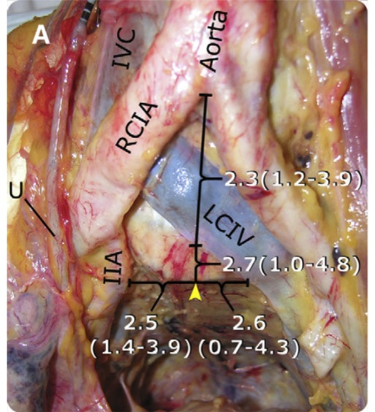
Notes:
Mesh attachment point in this picture is denoted by the yellow arrow. It is clear that this is in close proximity to the bifurcation of both the vena cava and aorta with the closest vessels being the LCIV and Right common iliac artery

Slide 41
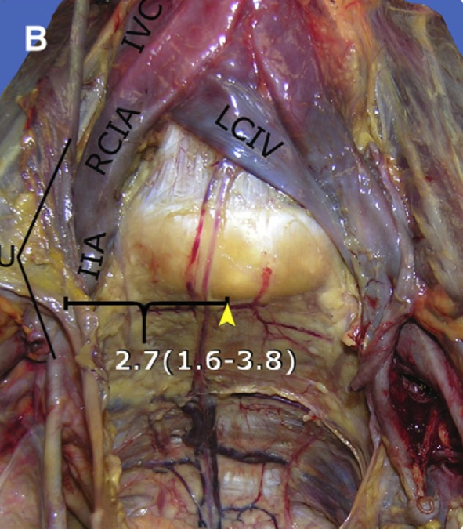
Notes:
The good news is that once you get the right spot- its usually pretty clear of any major vessels except for the middle sacral vein and artery which are usually easily managed with a bipolar energy source. Be careful too to not go too low into the sacral hollow since that’s where we find the sacral venous plexus which can cause some really troublesome bleeding if you’re not careful

Slide 42
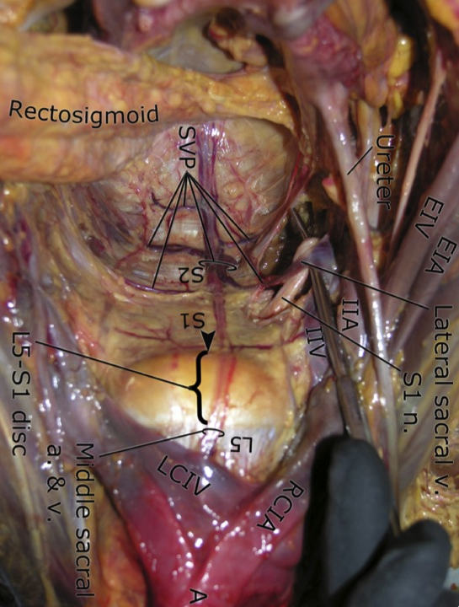
Notes:
This is the surgeon’s view, with the upper part of the picture representing the caudad region. The disc is clearly labelled with the area of mesh attachment shown by the black arrowhed. The proximity of large vessels, again is clearly shown.

Slide 43
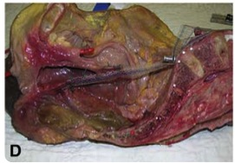

Slide 44
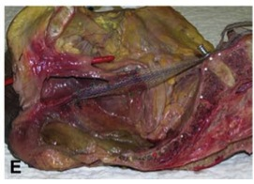

Slide 45
Notes:
Another picture to display this area of dissection

Slide 46
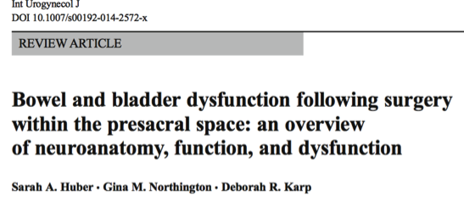
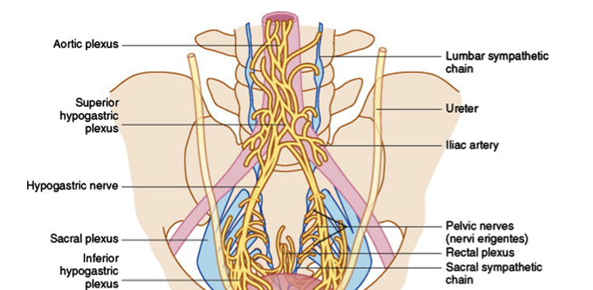
Notes:
Something that does require some mention is that we are also working in the area of the Suoerior and Inferior hypogastric plexuses. This was highlighted in a recent review by Sarah Huber and Debby Karp. This may explain some of the voiding dysfunction (18 %), dyspareunia (8 %), and defecatory dysfunction (10 – 50 %) we see after colpopexy

Slide 47
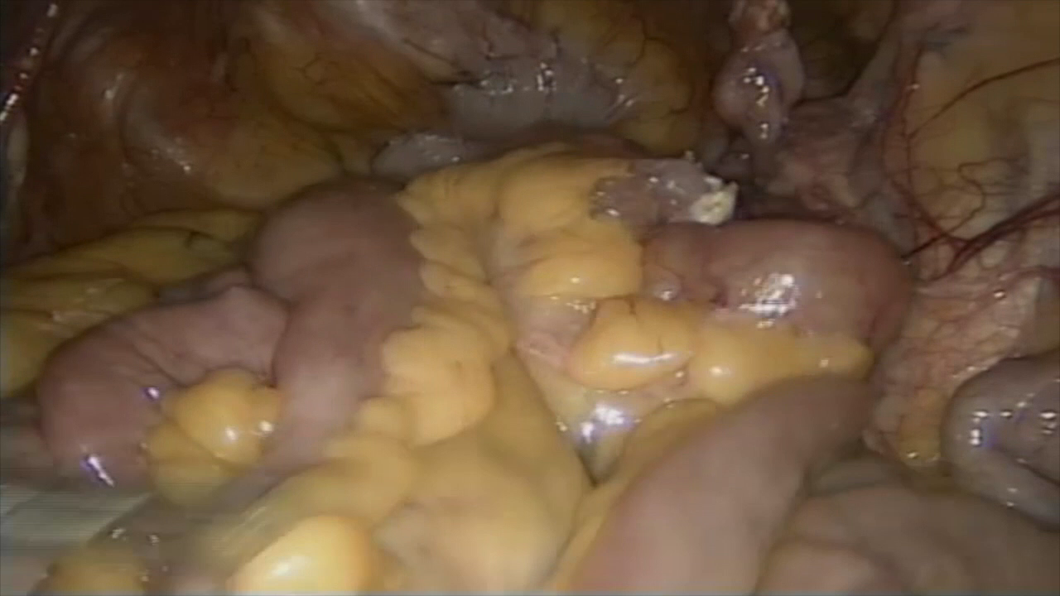

Slide 48
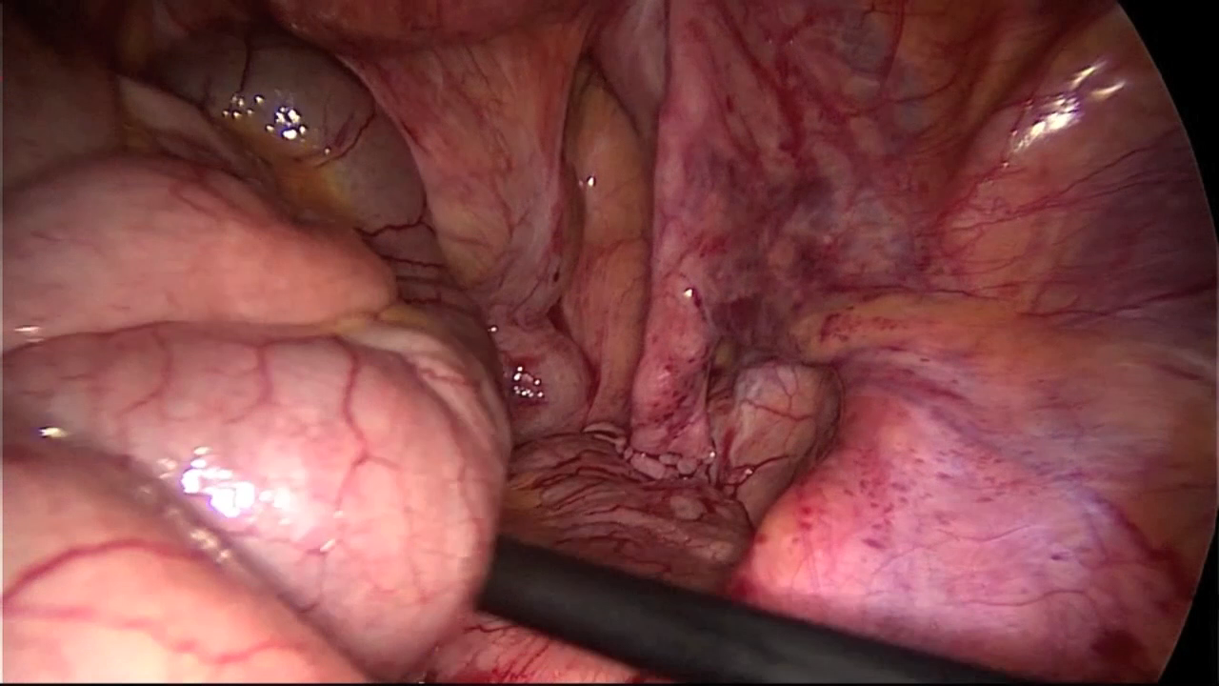

Slide 49
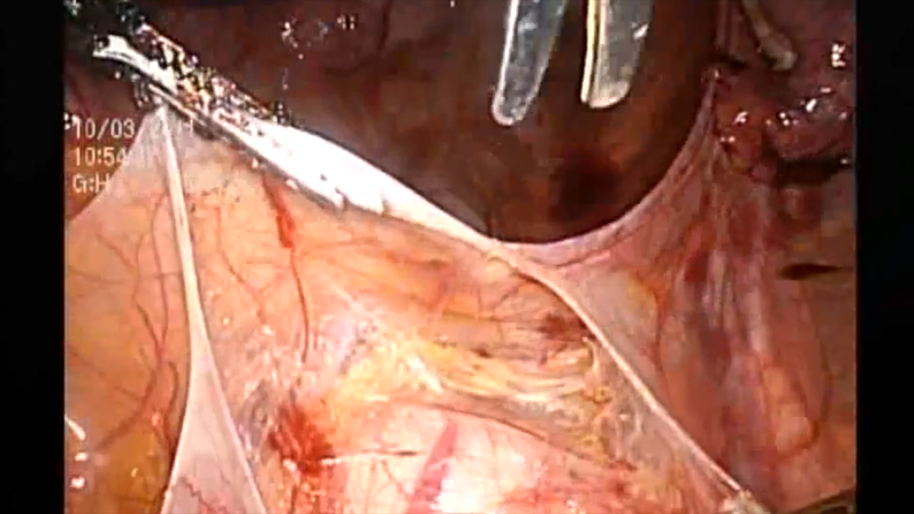

Slide 50
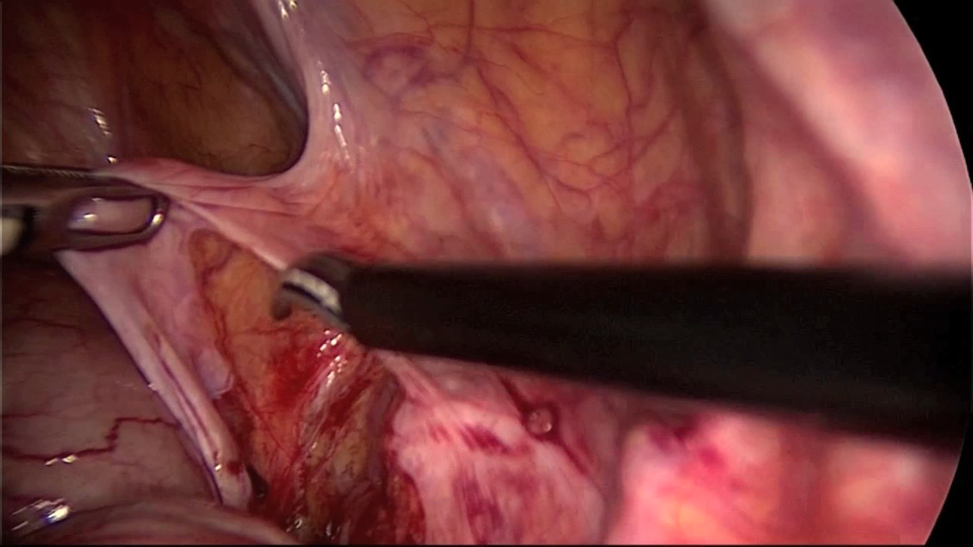

Slide 51
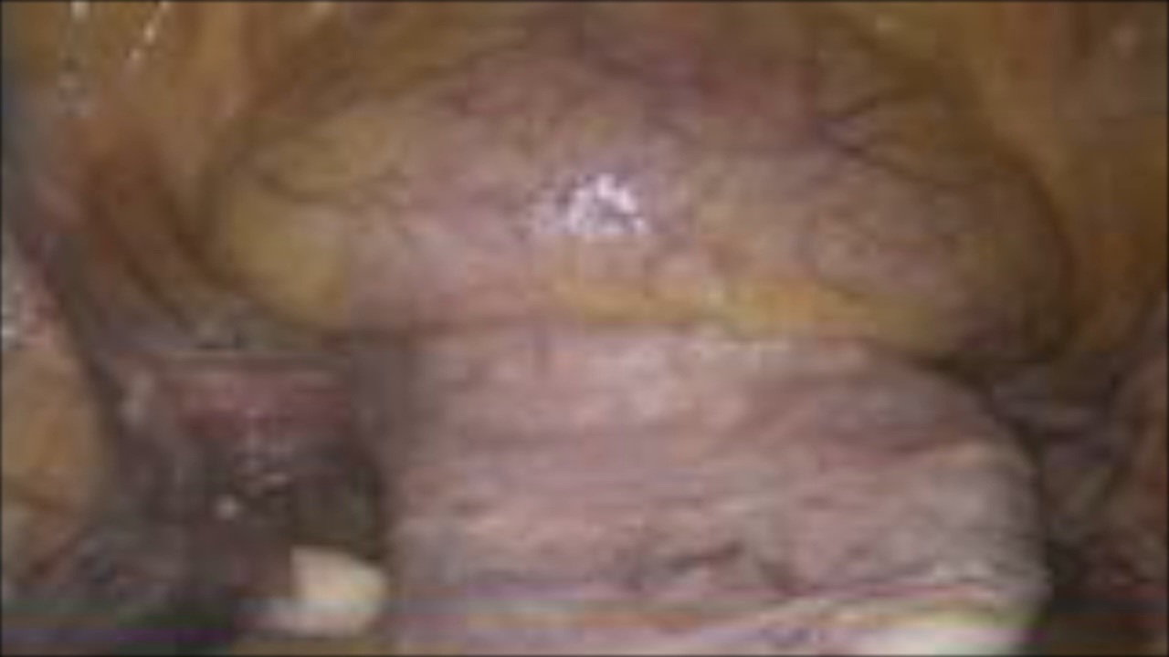

Slide 52
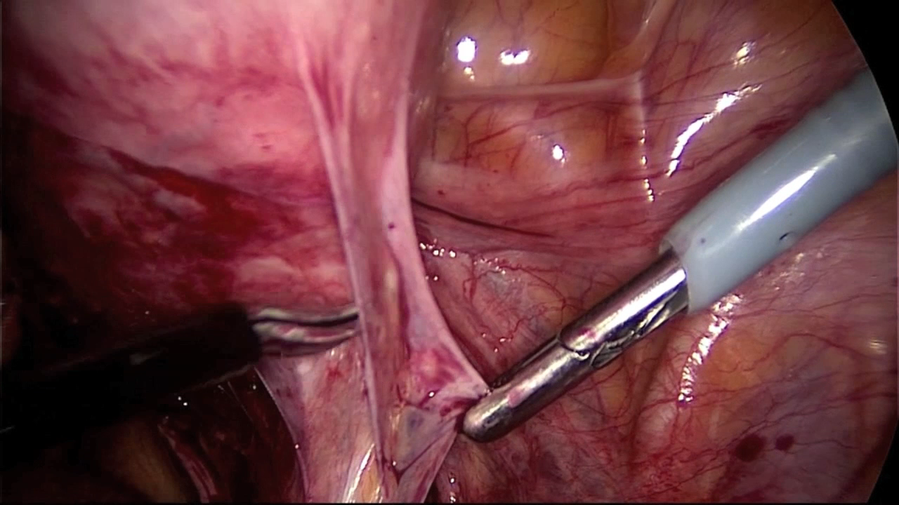

Slide 53
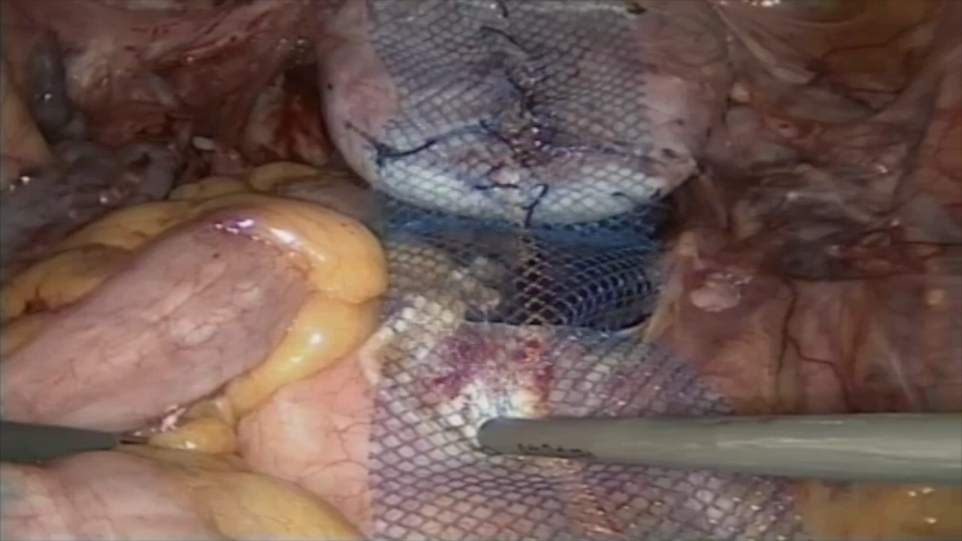

Slide 54
Patient selection

Slide 55
Patient selections: Issues to consider
Which compartment is actually involved? The apex is often the culprit
Age
Pain history
Sexual function
Activity level
Patient expectations
Medical condition

Slide 56
What is the age and activity level of the patient?
“Younger”
“Very Active”
“Older”
“Less Active”
Laparoscopic Sacral Colpopexy
(+/- supracervical hyst)
Vaginal surgery with possible mesh
in anterior compartment

Slide 57
How do we choose? Summary
Route of repair dependent on multitude of factors
Patient factors
  Age
  Primary or recurrent
  Presence of uterus
  Site of prolapse
  Co-morbidities
Surgeon factors
  Experience
  Preference

Slide 58
How do I choose?
Vaginal approach no mesh
  Primary surgery
    Primary recto/enterocele
    < Grade 3 cystocele
  Large uterine prolapse – vag hyst with sacrospinous/ HUSLS

Slide 59
How do I choose?
Sacrocolpopexy
  Shortened vagina
  Sexual function important
  All vault prolapse if possible
  Young and sexually active patient with uterine/ vault prolapse

Slide 60
How do I choose?
Vaginal approach with mesh
  Vault in a patient who isn’t suitable for sacrocolpopexy
  Recurrent cystocele with minimal vault prolapse

Slide 61

Download these slides for free at
www.urogynaecology.co.za

